Slide 1

PITCH - A – BOT SMART PARKING SYSTEM
ARJUN P S

Slide 2
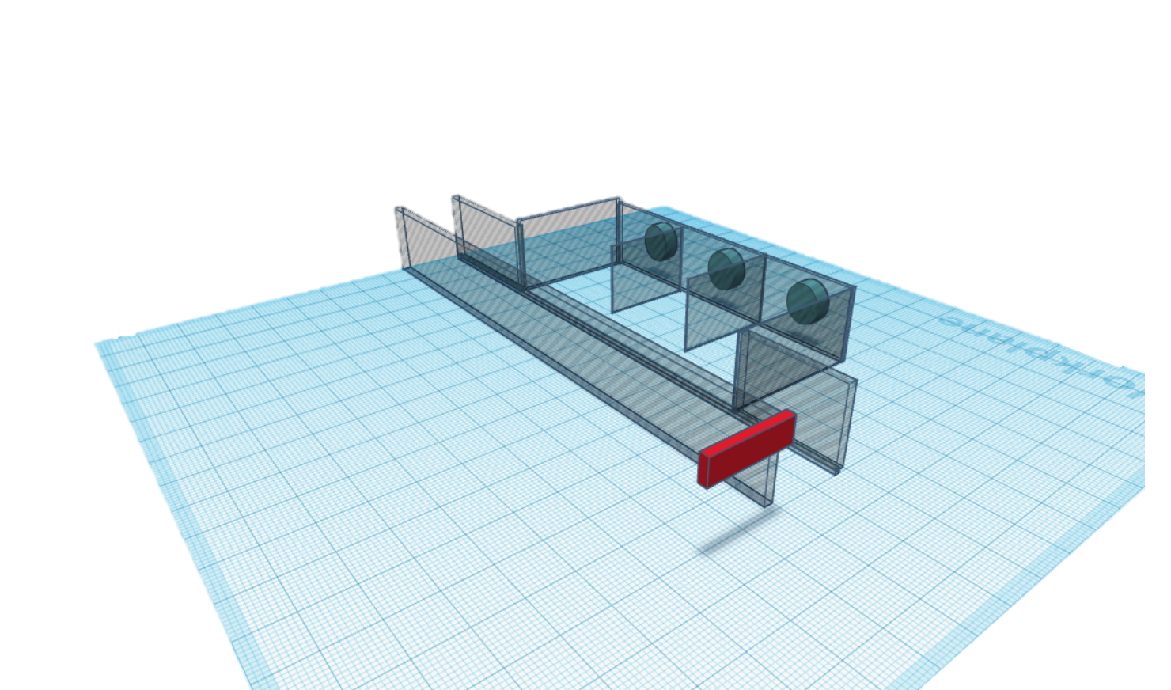
IDEA AND APPROACH
LAYOUT OF PARKING AREA -
ULTRASONIC SENSORS
LCD SCREEN

Slide 3
The parking lot designed here has three slots, each equipped with an ultrasonic sensor.
The length and width of each slot is chosen based on the average length and width of a car such that the car will be having at most 1 metre distance between it and the wall.
Ultrasonic sensor is preferred over IR sensor because it would be hard to receive signals from an IR sensor if the car parked is black in colour or is dirty.
A LCD display is used in front of the driveway for the driver to check for free slots to park the car or to drive to the next parking lot if its full.
The LCD screen shows total number of cars parked, number of free slots and information about occupancy of each slot.

Slide 4
COMPONENTS REQUIRED
Arduino uno
Ultrasonic sensors (x3 – each for a slot)
16x2 LCD display
Breadboard
Potentiometer
Jumper cables

Slide 5
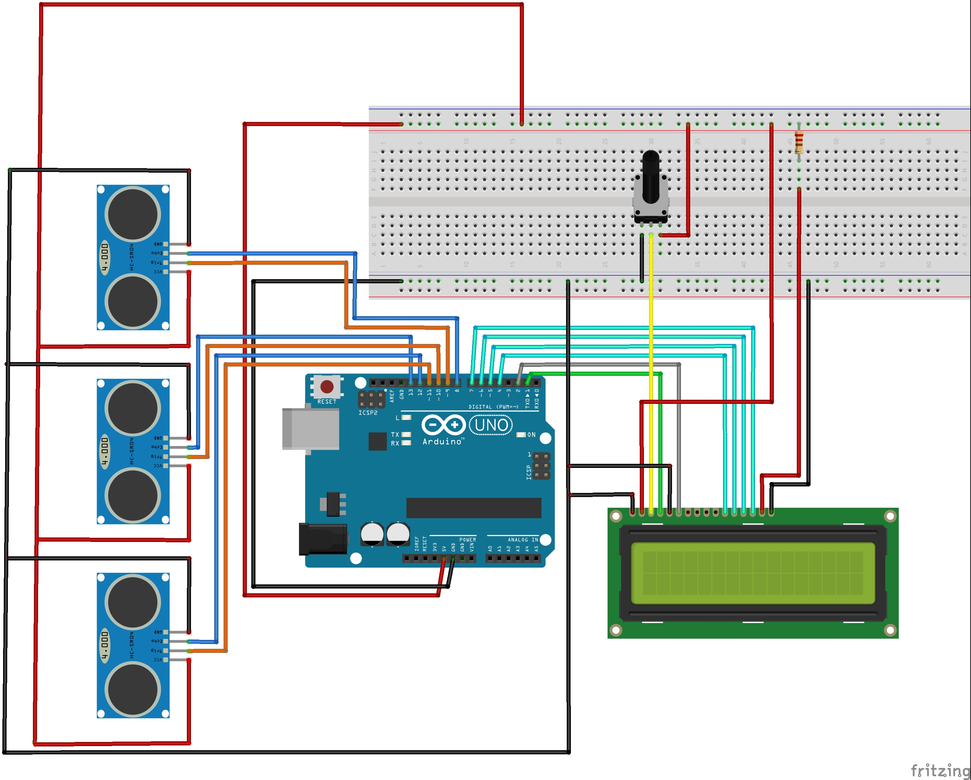
CONNECTION AND CIRCUIT DIAGRAM

Slide 6
TAKEAWAY
More about Arduino uno ( ports available, components and their uses )
Information about hardware’s used along with Arduino
Connecting different components to Arduino
Coding microcontroller in Arduino
How to approach a problem and solve it

Slide 7
RESOURCES
BOOKS- Programming Arduino : getting started with sketches by Simon Monk
YOUTUBE – RoboISM classes
WEBSITES -
www.arduino.cc
www.engineersgarage.com
www.howtomechatronics.com
www.circuitdigest.com
www.electronicshub.org
www.components101.com

Slide 8
Further developments possible
To make the project more user friendly, connect the project to a website where any user can monitor parking and pre book slots for a particular time period from any part of the world.
Automatically note down the car name (given by manufacturer) , colour, number and time period for which they were parked. This is helpful if an emergency or a critical situation arises.
Give the user directions to the nearest free slot available in the lot through the website.
Give the user the directions to the spot where he or she has parked his or her vehicle through the website.

Slide 9
VIDEO
https://youtu.be/3R5WGcD9af0

Slide 10
THANK YOU

